Slide 1
Lending Club Case Study
Presented By:
Akash Chaudhary
Snehal Patil

Slide 2
Business Objectives
The objective is to discern patterns that signal the likelihood of loan default, enabling informed actions like loan denial, adjustment of loan amounts, or offering loans to riskier applicants at higher interest rates.
By analyzing consumer and loan attributes, the lending club aims to comprehend key factors influencing loan default. This understanding helps optimize the company's portfolio and risk assessment.

Slide 3
Problem Solving Technique
Data Understanding
Data Cleaning
Univariate Analysis
Developed Insights
Multivariate Analysis
Recommendations
Data Understanding
Conclusion
Analysis
Feature Understanding
Data Cleaning
Feature Engineering

Slide 4
Data Understanding
Feature Understanding
Data_Dictionary.csv file provided all the feature definitions
More feature knowledge was gained by going through Risk Analytics concepts.
Feature knowledge was compared with the data and the data types provided in loan.csv
Data Understanding
Loan.csv file provided the Lending Club sample data.
In depth understanding was gained by looking at each of these columns to plan the best way to approach the problem statement.

Slide 5
Data Cleaning
Data Cleaning process involved:
Dropped columns based on our feature and data understanding.
Unique Identifier columns : id, member_id, url
Null columns : 'mths_since_last_major_derog', 'annual_inc_joint', 'dti_joint', 'verification_status_joint', 'tot_coll_amt', 'tot_cur_bal', 'open_acc_6m', 'open_il_6m', 'open_il_12m', 'open_il_24m', 'mths_since_rcnt_il', 'total_bal_il', 'il_util', 'open_rv_12m', 'open_rv_24m', 'max_bal_bc', 'all_util', 'total_rev_hi_lim', 'inq_fi', 'total_cu_tl', 'inq_last_12m', 'acc_open_past_24mths', 'avg_cur_bal', 'bc_open_to_buy', 'bc_util', 'mo_sin_old_il_acct', 'mo_sin_old_rev_tl_op', 'mo_sin_rcnt_rev_tl_op', 'mo_sin_rcnt_tl', 'mort_acc', 'mths_since_recent_bc', 'mths_since_recent_bc_dlq', 'mths_since_recent_inq', 'mths_since_recent_revol_delinq', 'num_accts_ever_120_pd', 'num_actv_bc_tl', 'num_actv_rev_tl', 'num_bc_sats', 'num_bc_tl', 'num_il_tl', 'num_op_rev_tl', 'num_rev_accts', 'num_rev_tl_bal_gt_0', 'num_sats', 'num_tl_120dpd_2m', 'num_tl_30dpd', 'num_tl_90g_dpd_24m', 'num_tl_op_past_12m', 'pct_tl_nvr_dlq', 'percent_bc_gt_75', 'tot_hi_cred_lim', 'total_bal_ex_mort', 'total_bc_limit', 'total_il_high_credit_limit‘
Constant columns : 'pymnt_plan', 'initial_list_status', 'collections_12_mths_ex_med', 'policy_code', 'application_type', 'acc_now_delinq', 'chargeoff_within_12_mths', 'delinq_amnt', 'tax_liens‘
Similar/Subset Columns : grade (as sub_grade includes grade information as well)
Descriptive Text Columns : desc, title
Employee Title, Zip Code, Address : emp_title, zip_code, addr_state
Post Loan Approval Data : last_credit_pull_d, last_pymnt_amnt, last_pymnt_d, total_rec_late_fee, total_rec_prncp, total_rec_int, out_prncp, out_prncp_inv, total_pymnt, total_pymnt_inv, next_pymnt_d, inq_last_6mths, delinq_2yrs
Post Charge-off Data : recoveries, collection_recovery_fee

Slide 6
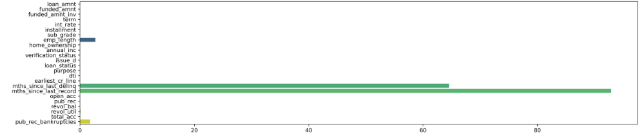
Data Cleaning
Deleted rows based on our feature and data understanding.
loan_status tells us if the loan is paid-off, defaulted or currently in-progress. Since we're not predicting the future status of an on-going loan, it seems wise to exclude it from our analysis.
Dropped columns having more than 60% null values.
Dropped 'mths_since_last_delinq' and 'mths_since_last_record' columns based on the above Bar plot.

Slide 7
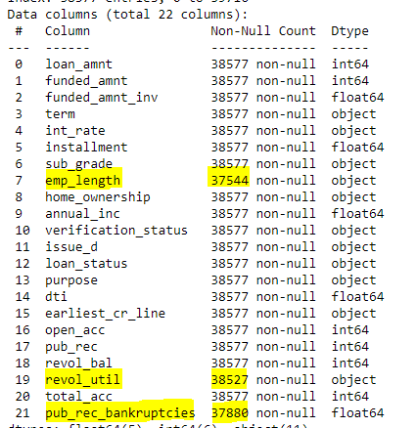
Data Cleaning
Handled Null Values in all columns having less than 60% null values.
'pub_rec_bankruptcies' provides the number of bankruptcies that has been filed for the borrower as per public records. Ideally higher chance of loan approval stands for the borrower who has no such past records i.e., the number is 0. For our analysis, this null value was considered as 0 i.e., no bankruptcies filed.
'revol_util' signifies the percentage of revolving credit that a borrower is utilizing for the loan. On analyzing the data once again, it was observed that Revolving Credit Utilization was null only where Revolving Credit Balance was 0. Accordingly the null values were filled with 0%.
'emp_length' indicates the borrower's years of employment which contains categorical data. Null values cannot be handled just by filling with mean/median/mode values as it can exaggerate the dataset and wrongfully impact our analysis, hence, the null values were not handled.

Slide 8
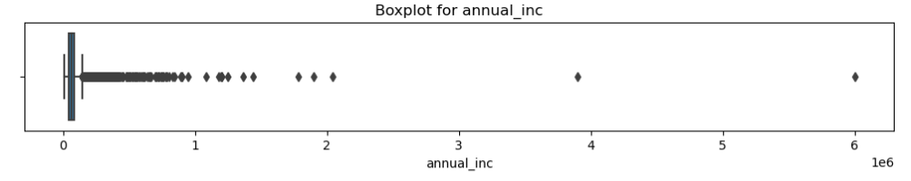
Data Cleaning
Handled Data Types.
'%‘ symbols were removed from 'int_rate' and 'revol_util‘ columns and changed data type as float.
Handled Outliers to avoid any exaggeration in our analysis.
Plotted multiple box plots and observed that only ‘annual_inc’ column had outliers which were significant and were handled accordingly.

Slide 9
Feature Engineering
Feature Engineering process involved:
Loan ‘term’ was in text format which was converted to Integer for analysis purpose.
Interest rate ‘int_rate’ was rounded off to nearest integer to create Interest rate buckets having values 1 - 24.
Employment experience containing range of years, was converted to Integer for analysis purpose.
Time Series Data Columns like ‘earliest_cr_line’ and ‘issue_d’ were converted to 'yyyymm' format for ease of analysis.
Borrower's Monthly debt ratio ‘dti’ ranges between 0 - 30, and was binned for intervals of 5.
Revolving Credit Utilization rate ranges between 0% - 100%, and was binned for intervals of 10.
Earliest Credit Line since the issue date (‘issue_d’ – ‘earliest_cr_line’) could give some good insights which we later analyze.
Increase in Credit Lines (‘total_acc’ – ‘open_acc’) also could give some good insights which we later analyze.

Slide 10
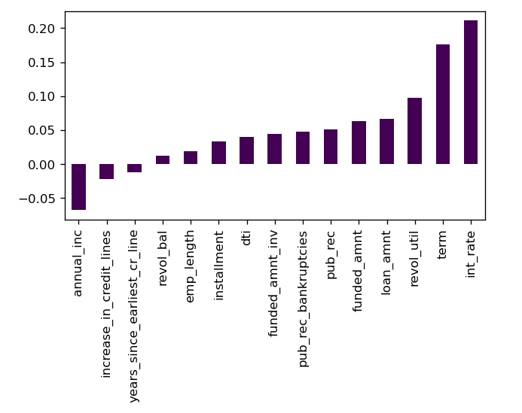
Univariate Analysis
Correlation Plot with Continuous Variables
Insights
From the plot we can clearly observe that 'Interest Rate' is directly proportional to the Defaulted i.e., if the Interest Rate is higher, borrower is more prone to Defaulting.

Slide 11
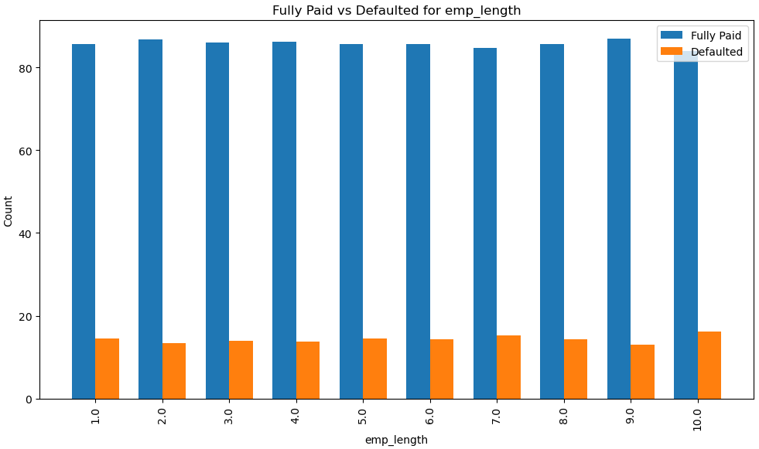
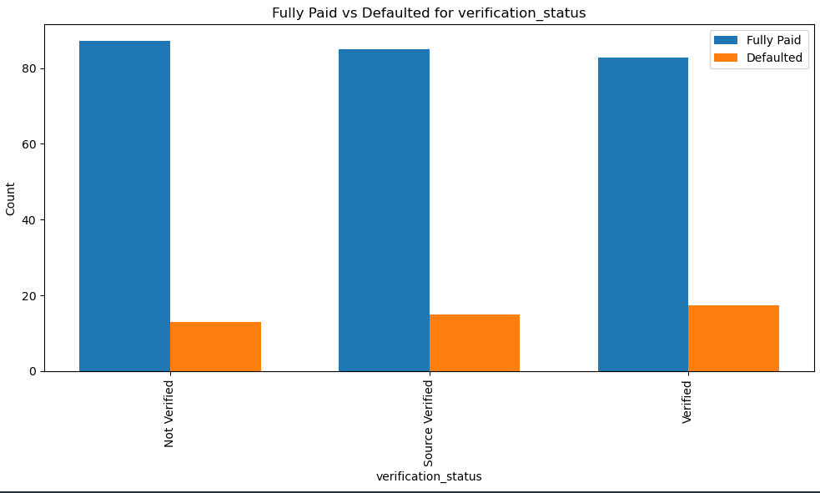
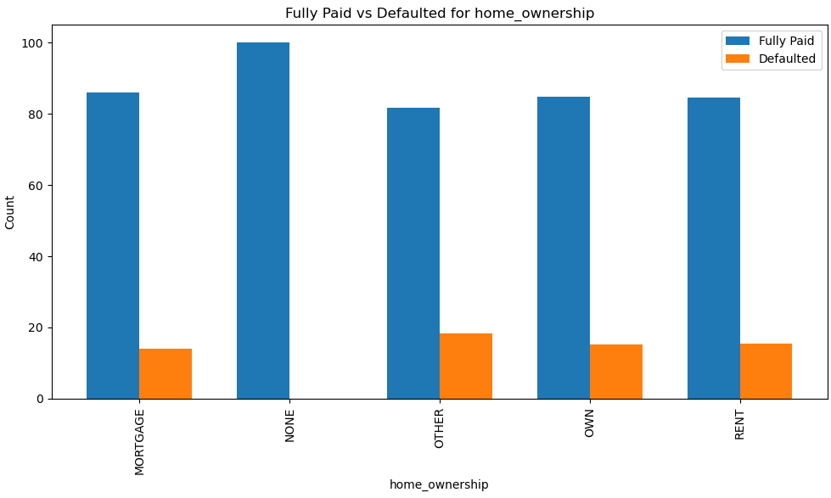
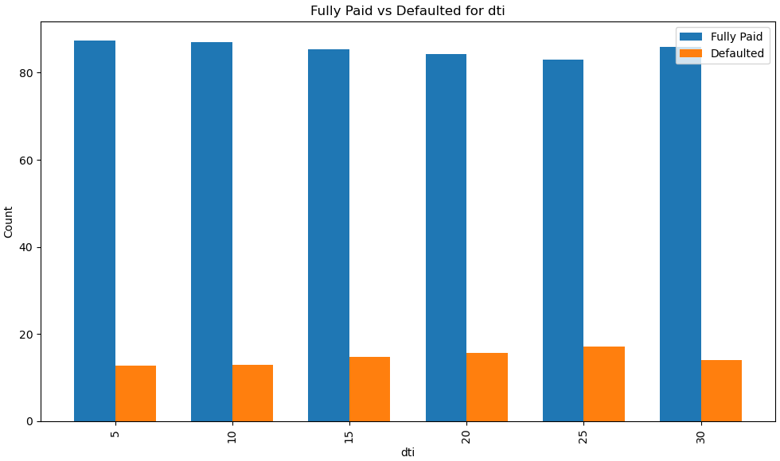
Univariate Analysis
Correlation Plot with Categorical Variables
Insights
Plot observation showed that Attributes like 'Employment Term in current company', 'Borrower Verification Status', 'Home Ownership', 'Number of derogatory public records', 'Borrowers monthly debt ratio' don't show any significant pattern and can be concluded as non-impacting features.

Slide 12
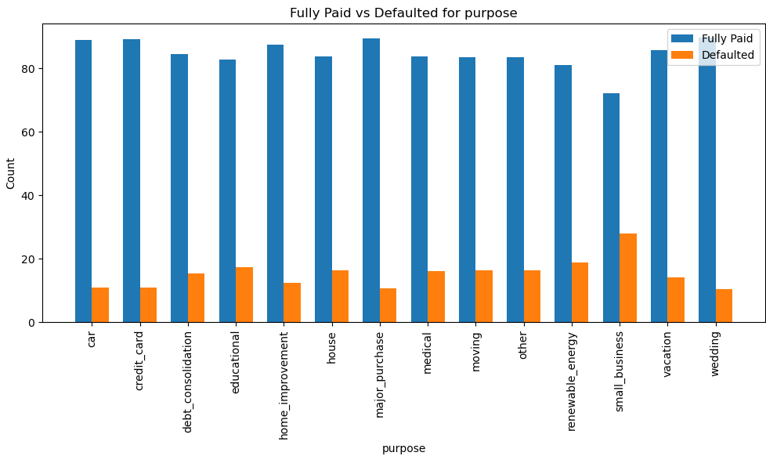
Univariate Analysis
Correlation Plot with Categorical Variables
Insights
Though Purpose for loan doesn't show any pattern, but it is keen to observe that borrowers taking loan for 'small_business' are more prone to defaulting.

Slide 13
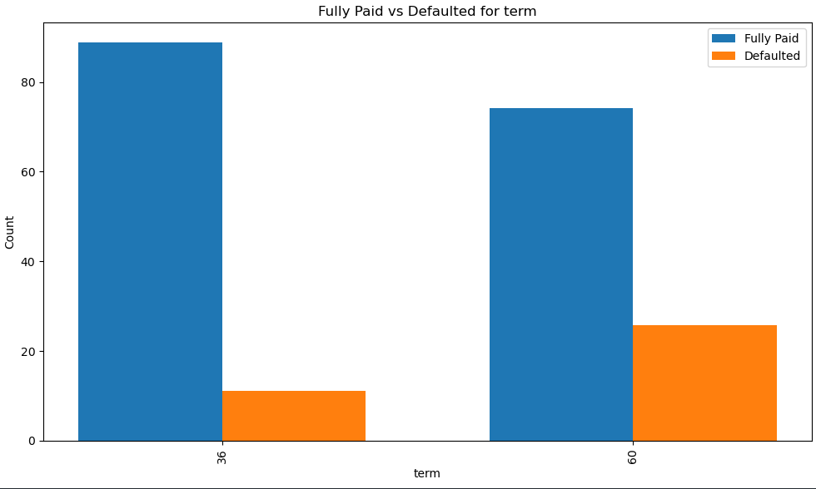
Univariate Analysis
Correlation Plot with Categorical Variables
Insights
For Loan term of 60 months the defaulters count is significantly higher than that of 36 months, which gives a clear sign that an increase in the Loan Repayment term can very likely end up in a Default scenario.

Slide 14
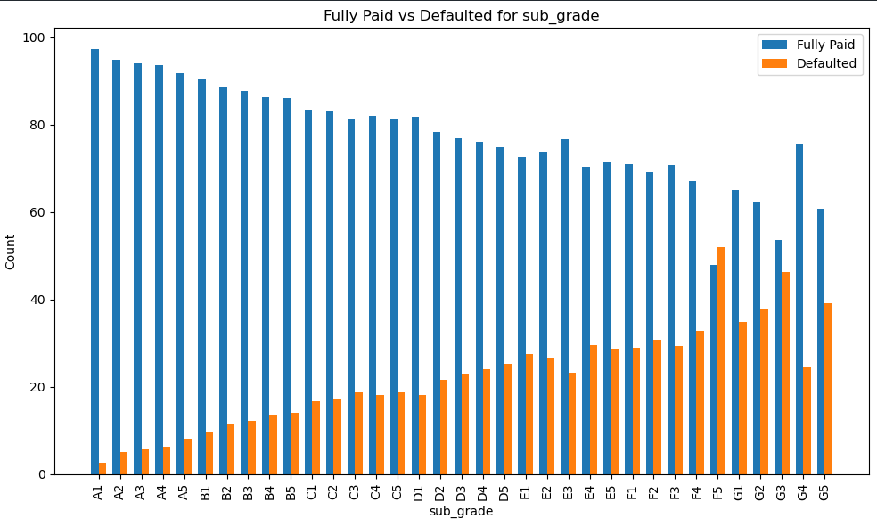
Univariate Analysis
Correlation Plot with Categorical Variables
Insights
For SubGrade, as we go from - A1 to A5 up until G5, the rate of defaulting increases significantly. This pattern is most significant and we can wisely conclude that lower SuGrade (A > B > C > D > E > F > G) have higher possibility of Defaulting.

Slide 15
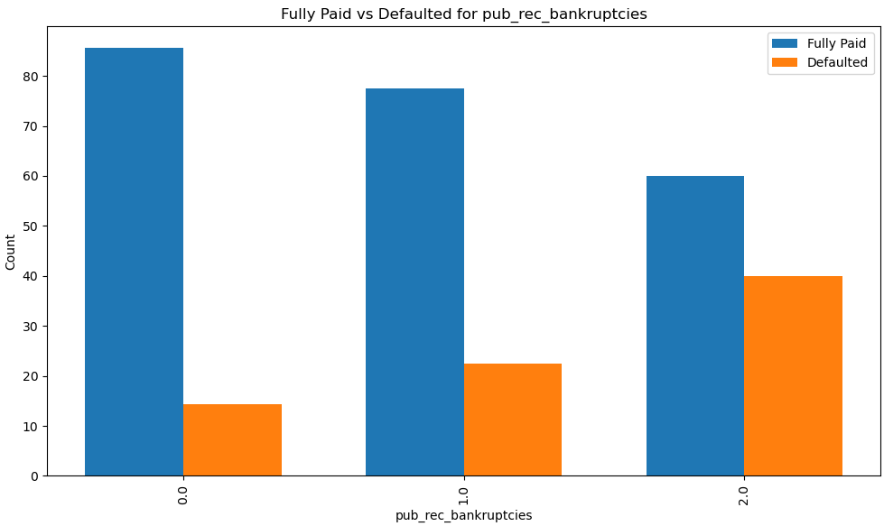
Univariate Analysis
Correlation Plot with Categorical Variables
Insights
Bankruptcy records show a significant pattern as it shows that the chances of Defaulting increases with increasing past bankruptcy records.

Slide 16
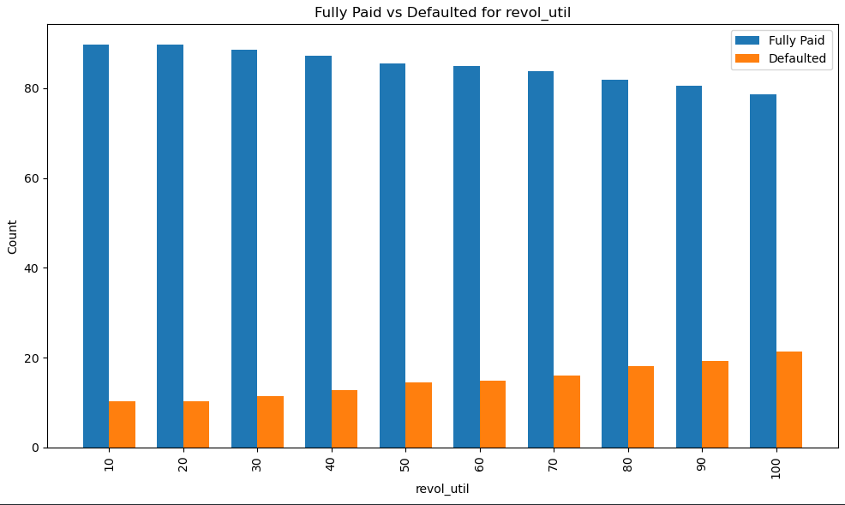
Univariate Analysis
Correlation Plot with Categorical Variables
Insights
Revolving Utilization Credit also shows significant pattern. The plot says that higher the Borrower's Utilization rate, increases the chance of Defaulting.

Slide 17
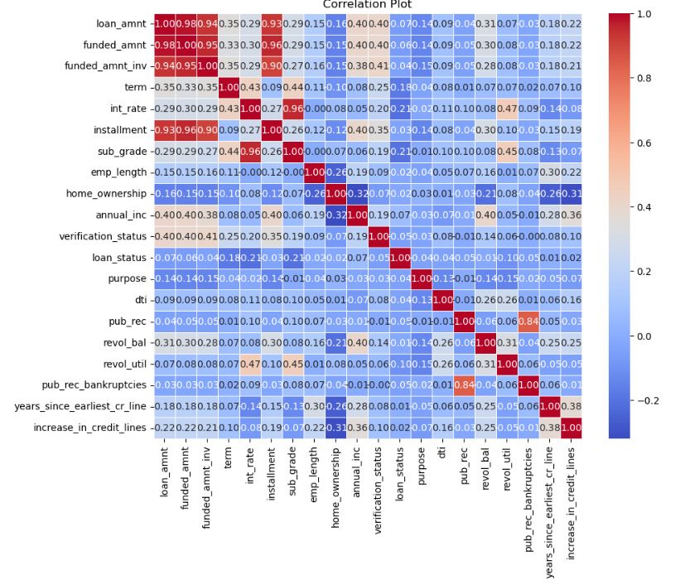
Multivariate Analysis
Correlation Plot for the whole Data Model
Insights
Nothing significant was observed from the Correlation Matrix.

Slide 18
Conclusion
Developed Insights
We can observe that Attributes like 'Employment Term in current company', 'Borrower Verification Status', 'Home Ownership', 'Number of derogatory public records', 'Borrowers monthly debt ratio' don't show any significant pattern and we can conclude that they do not impact the borrower directly on his/her loan repayment journey.
Though Purpose for loan doesn't show any pattern, but it is keen to observe that borrowers taking loan for 'small_business' are more prone to defaulting.
For Loan term of 60 months the defaulters count is significantly higher than that of 36 months, which gives a clear sign that an increase in the Loan Repayment term can very likely end up in a Default scenario.
For SubGrade, as we go from - A1 to A5 up until G5, the rate of defaulting increases significantly. This pattern is most significant and we can wisely conclude that lower SuGrade (A > B > C > D > E > F > G) have higher possibility of Defaulting.
Bankruptcy records show a significant pattern as it shows that the chances of Defaulting increases with increasing past bankruptcy records.
Revolving Utilization Credit also shows significant pattern. The plot says that higher the Borrower's Utilization rate, increases the chance of Defaulting.

Slide 19
Conclusion
Recommendations
Lower Sub Grades (D, E, F, G) is the most significant reason for Defaulting and should be carefully undertaken.
Higher Sub Grades (A, B, C) should be given more loans as there is very less chance of Defaulting.
Higher Interest Rate along with larger loan term (more than 36 months) is also one of the most significant reason for Defaulting and should be carefully undertaken.
Borrowers with high Revolving Credit Utilization rate should be thoroughly investigated beforehand.
And last but not the least, loan taken for Purpose of Small Business should be carefully analyzed and thoroughly investigated as well.

Slide 20
Thank You

